Slide 1
AI-Powered Real-Time News Effects on Stock Market Changes
Anapana Tanoj Kumar

Slide 2

Introduction
The stock market is a dynamic environment where prices fluctuate due to various factors, with real-time news being a major driver.
Events like corporate earnings or geopolitical developments can cause immediate price shifts.
For instance, a major acquisition announcement might surge a stock, while a natural disaster could lower prices, making news analysis crucial for investors.

Slide 3
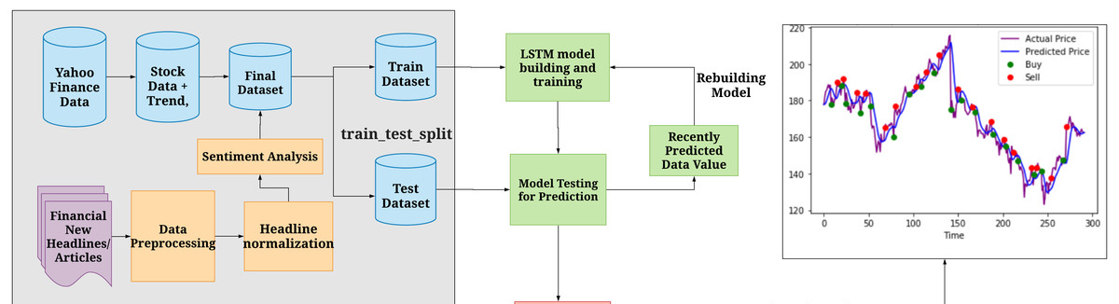
Project Goals
This project aims to develop an AI-powered system to predict stock market changes by analyzing real-time news.
Unlike traditional models focusing on numerical data, it uses natural language processing to process news articles, integrates them with stock data, and deploys predictions via an interactive interface, enabling investors to respond swiftly to market changes with accurate insights.

Slide 4
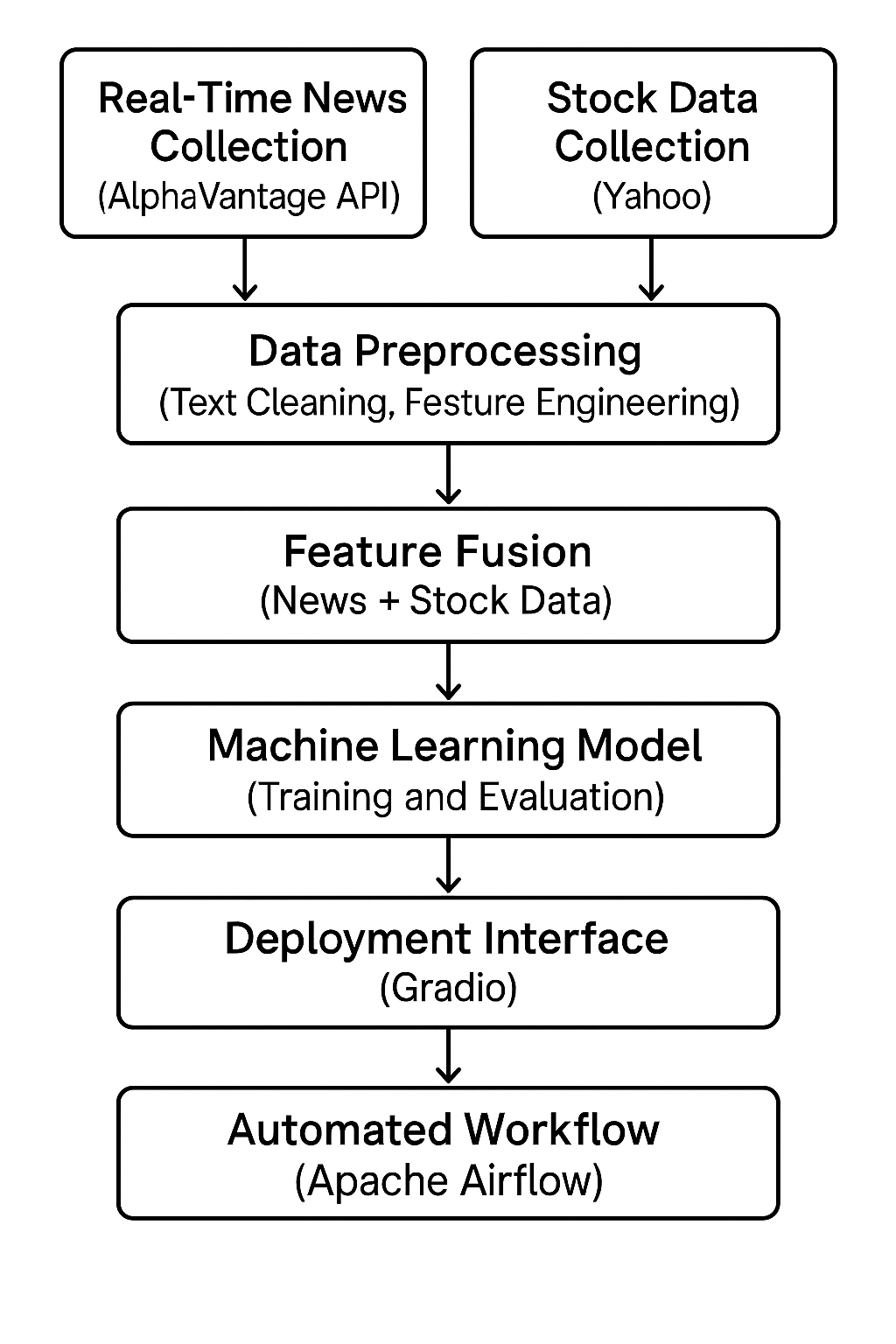
System Architecture

Slide 5
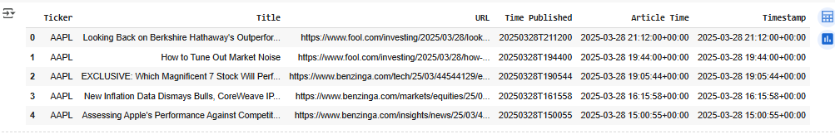
News Data Collection
The method began with data collection, focusing on news for 25 major tickers like AAPL and MSFT using the Alpha Vantage API.
Over 30 days, over 64,269 articles were gathered, covering business and technology topics.
This dataset, saved as daily news data, includes titles, timestamps, and URLs, providing a comprehensive source for understanding news-driven market trends in real time.

Slide 6
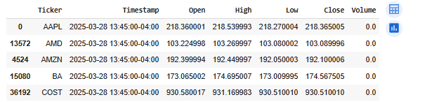
Stock Data Collection
Data preprocessing merged news and stock data within a 3-hour window per ticker, aligning news with market activity.
News titles were cleaned using spaCy, involving lowercasing and lemmatization, then converted into 768-dimensional BERT embeddings using the bert-base-uncased model.
The merged dataset, combining stock features and embeddings, was saved ready for analysis.

Slide 7
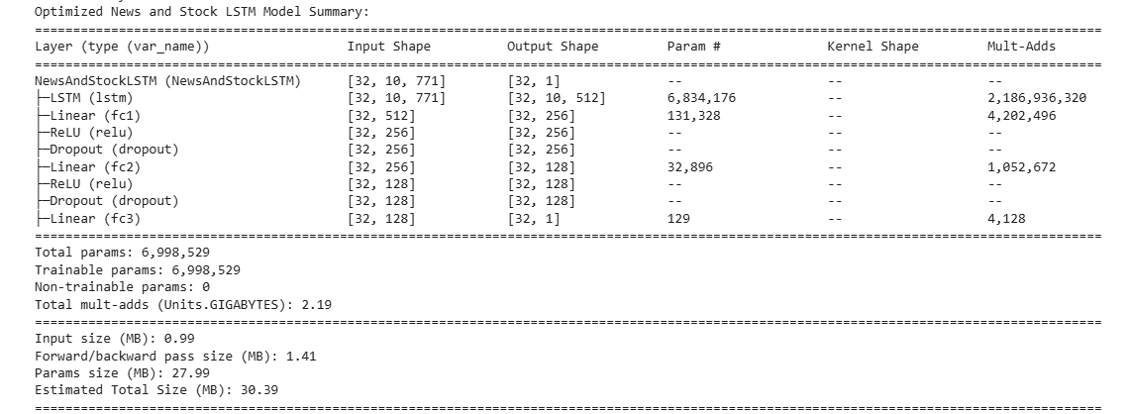
Method -Model Architecture
The core predictive model is a Long Short-Term Memory (LSTM) neural network, ideal for sequential stock data.
It processes a 771-dimensional input of stock features and BERT embeddings, featuring three LSTM layers with 512 units each, followed by dense layers to predict closing prices.
Dropout at 0.2 prevents overfitting, ensuring robust performance across diverse market conditions.

Slide 8
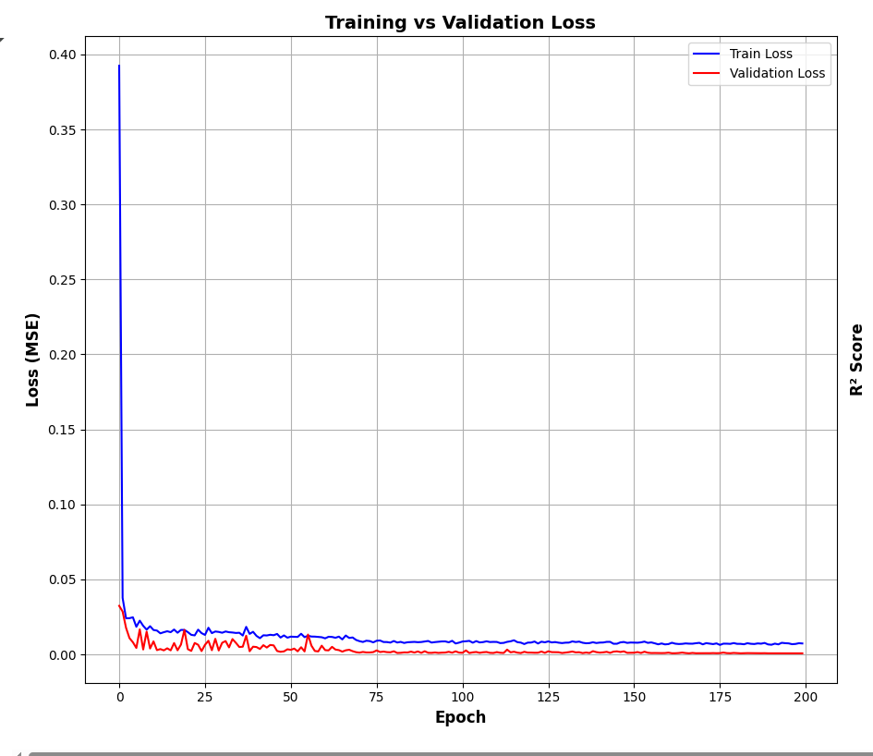
Method -Training Process
The LSTM model was trained for 200 epochs using the Adam optimizer with a 0.001 learning rate and Mean Squared Error loss.
Early stopping with a patience of 50 and a learning rate scheduler were applied to optimize training..
This setup ensures the model learns effectively, balancing accuracy and computational efficiency for real-time stock prediction tasks.
Training vs Validation Loss plot indicates losses stabilizing at 0.01 MSE, with minimal overfitting

Slide 9

Results -Performance Metrics
The LSTM model achieved a Test MSE of 31.1385 dollars², an RMSE of 5.5802 dollars, and an R² score of 0.9991, explaining 99.91% of price variance.
The automated pipeline’s simplified model reported a better RMSE of 4.12 dollars, likely due to a smaller, less volatile dataset.
These metrics highlight the model’s high accuracy and reliability for stock prediction.

Slide 10
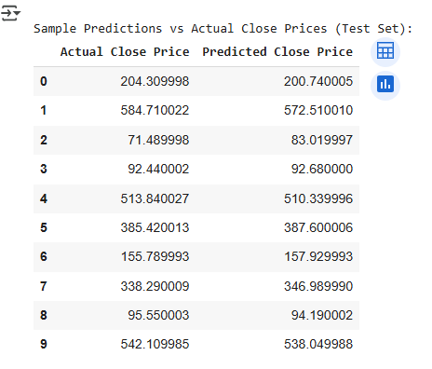
Results - Sample Predictions
Sample predictions show the model’s accuracy: an actual price of $204.31 was predicted as $200.74, with a $3.57 error, while $92.44 was predicted as $92.68, with a $0.24 error.
However, larger errors occurred at extremes, like $71.49 predicted as $83.02, indicating potential challenges with low-priced stocks, suggesting the need for further model adjustments in future.

Slide 11
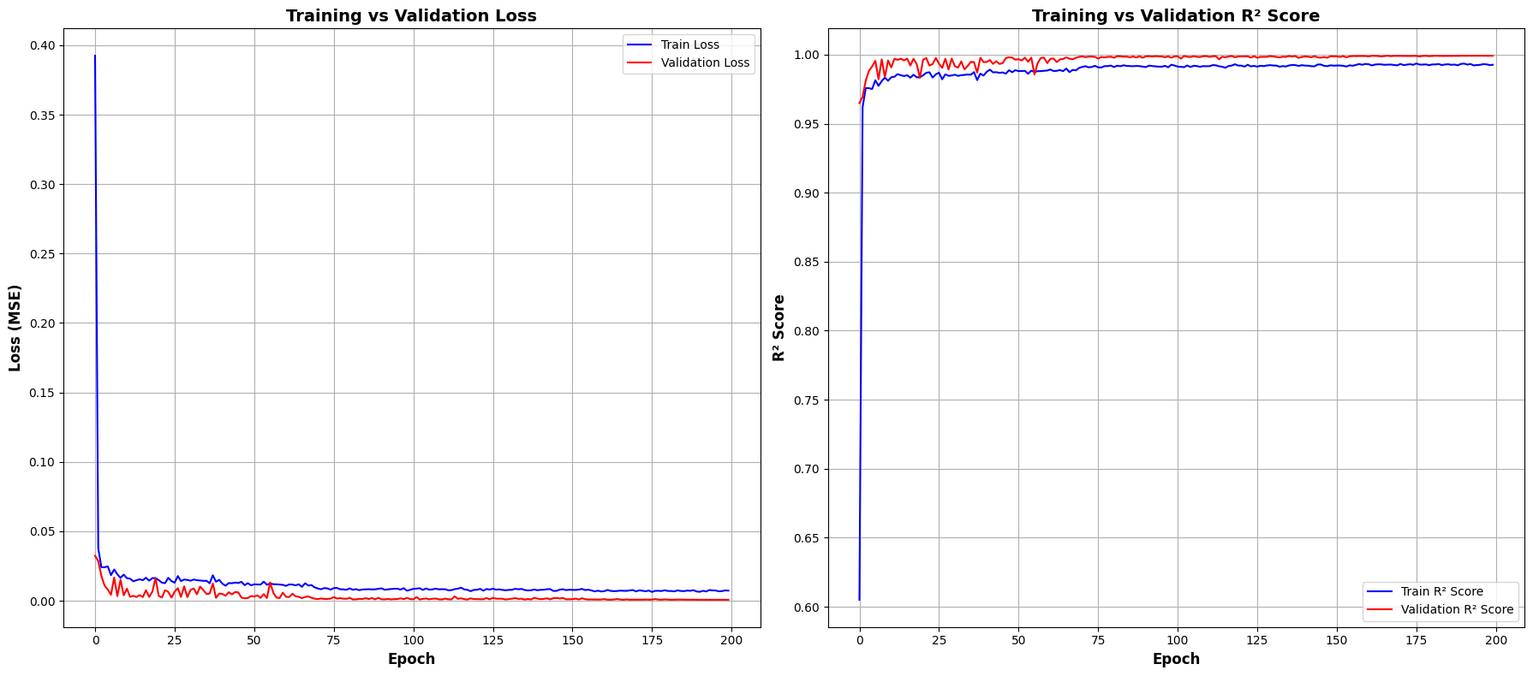
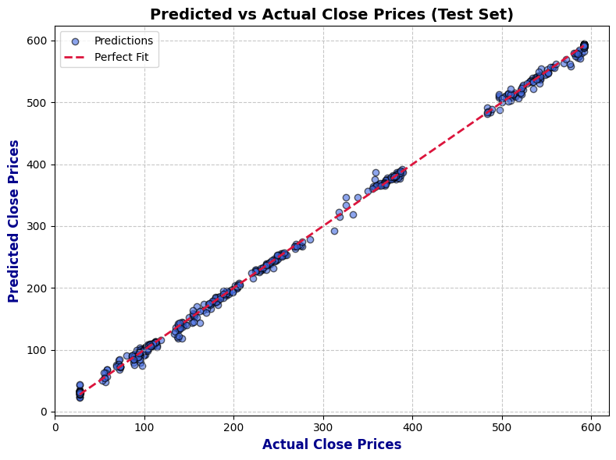
Results - Visual Analysis
The Predicted vs Actual Close Prices shows points aligning closely with the perfect fit line, reflecting the R² score of 0.9991.
The Training vs Validation R² Score shows R² scores reaching 0.95, confirming the model’s robust generalization on unseen data.

Slide 12
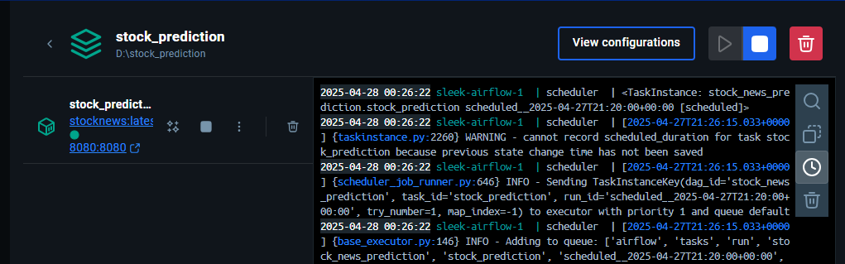
ML-Ops - Tools Used
The project utilized diverse tools: Alpha Vantage API and yfinance for data collection, pandas, spacy, and transformers for preprocessing, and torch for LSTM modeling.
Apache Airflow automated the pipeline, while Gradio facilitated deployment.
Visualization was handled by matplotlib, enabling plots like training loss, ensuring a seamless workflow from data collection to real-time stock prediction deployment.

Slide 13
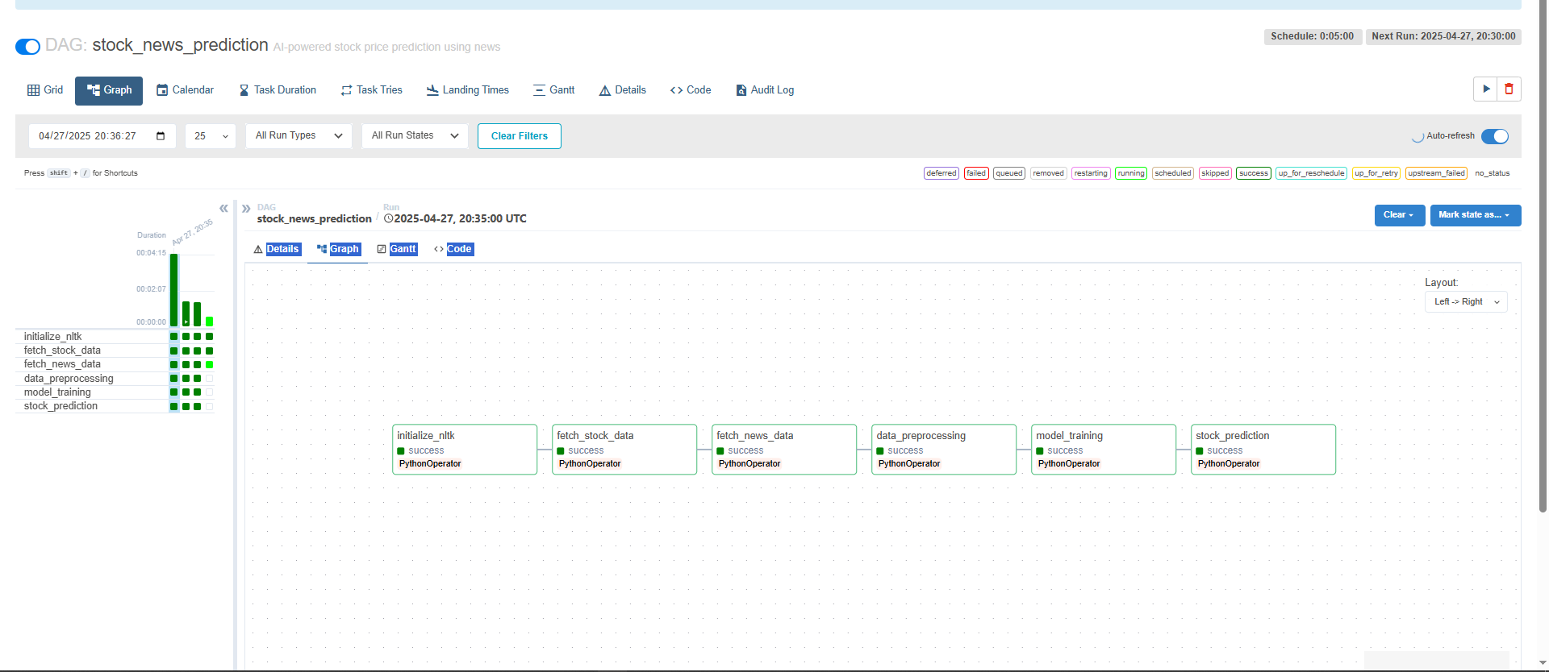
ML-Ops - Training and Automation
The training pipeline loaded merged_data_with_embeddings, scaled features with StandardScaler, and split data into 60/20/20 for training, validation, and testing.
The Airflow DAG, stock_news_prediction, runs every 5 minutes since April 24, 2025, executing tasks like data fetching and model training.
Outputs include news data and predictions, with logs and plots ensuring effective monitoring of the automated process.

Slide 14
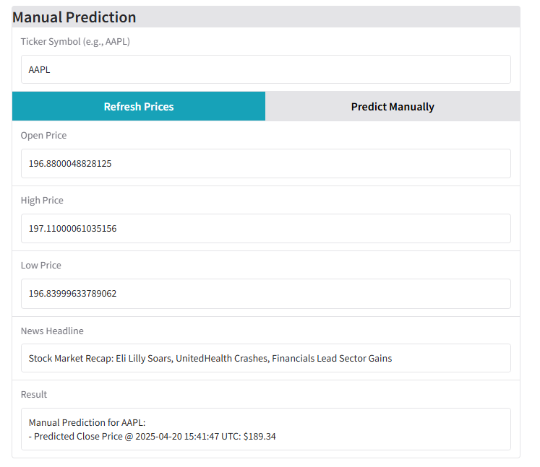
Deployment - Manual
In manual deployment, users input a ticker like AAPL and a news headline, receiving a predicted closing price such as $189.34 at 2025-04-20 15:41:47 UTC.

Slide 15
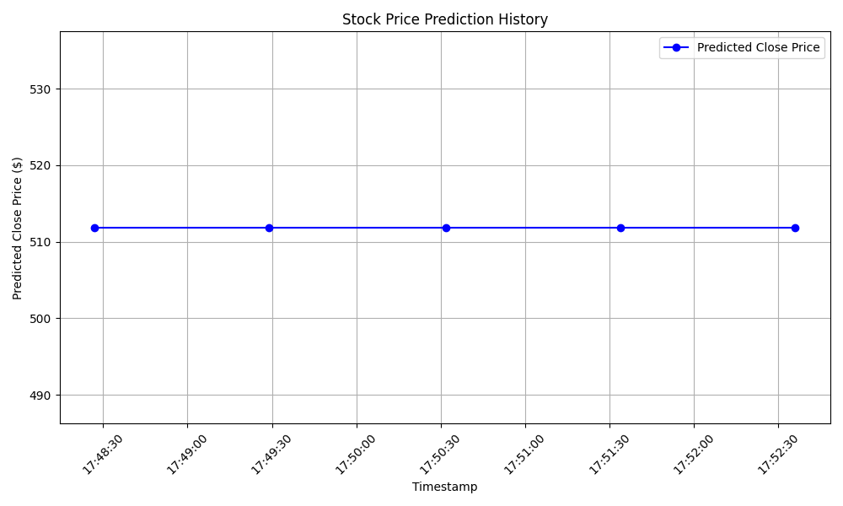
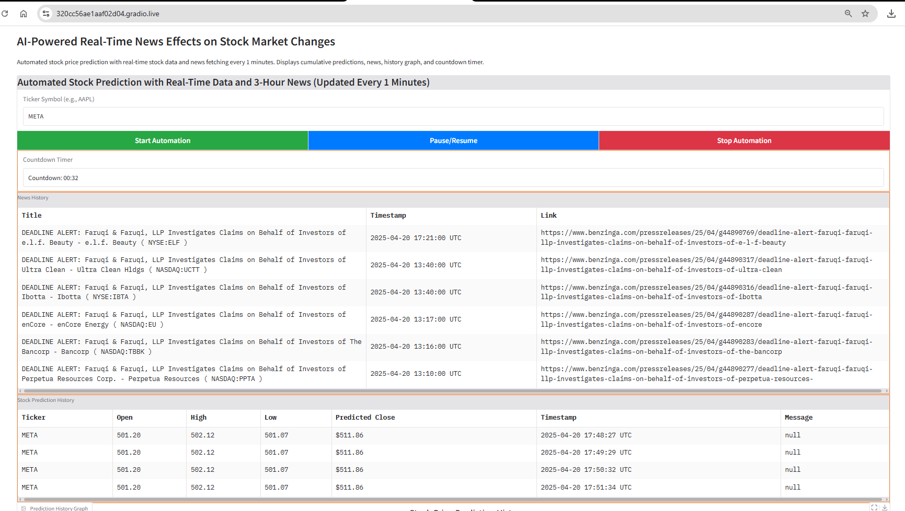
Deployment - Automated Modes
In automated deployment, users input a ticker (such as META), and the system updates every minute, collecting news within a 3-hour window for the specified ticker.

Slide 16
Conclusion
The project successfully achieved real-time stock prediction using news, with an R² score of 0.9991 and an RMSE of 4.12 dollars, as deployed via Gradio. It highlighted news’ impact on stock prices and the value of NLP in prediction accuracy.
Future work includes exploring transformers, adding social media data, and deploying on AWS for broader accessibility.

Slide 17
References
Bollen, J., Mao, H., & Zeng, X. (2011). Twitter mood predicts the stock market. Journal of Computational Science, 2(1), 1–8. https://doi.org/10.1016/j.jocs.2010.12.007
Brown, T., Mann, B., Ryder, N., et al. (2020). Language models are few-shot learners. Advances in Neural Information Processing Systems, 33, 1877–1901. https://arxiv.org/abs/2005.14165
Devlin, J., Chang, M.-W., Lee, K., & Toutanova, K. (2019). BERT: Pre-training of deep bidirectional transformers for language understanding. Proceedings of the 2019 Conference of the North American Chapter of the Association for Computational Linguistics: Human Language Technologies, 1, 4171–4186. https://arxiv.org/abs/1810.04805

Slide 18
Thank You!!!
Q & A

